Slide 1

House Price Prediction
Presenters:
John Lee
Nathan Nusaputra
Ryan Sawasaki
August 05, 2020
Notes:
Hi, we are John, Nathan, and Ryan and we’ll be presenting on our house price prediction machine learning models.
F11

Slide 2
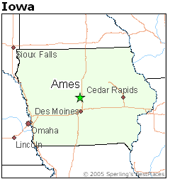
Introduction
House Price Prediction - Kaggle
Regression Problem
Steps:
Exploratory Data Analysis
Formulate Baseline
Linear Regression Model
Decision Trees with Ensembling Methods
Neural Network
Dataset: https://www.kaggle.com/c/house-prices-advanced-regression-techniques/overview
Notes:
The house price prediction data consists of houses sold in Ames, Iowa between 2006 and 2010. Our goal is to use the training data and predict the house price of each sample in the test data which is a regression problem.
We began with an exploratory data analysis to understand the data. Then we created a baseline to compare to our more advanced models which include feature engineering and hyperparameter tuning on linear regression, decision trees with ensembling methods, and neural networks. Each of these sections will be further discussed.

Slide 3
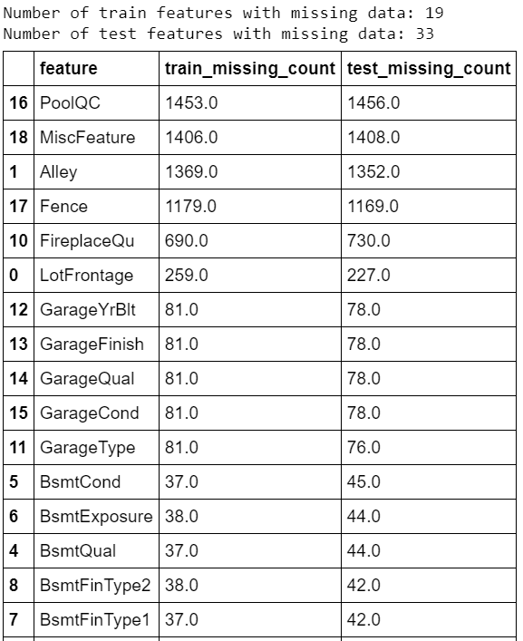
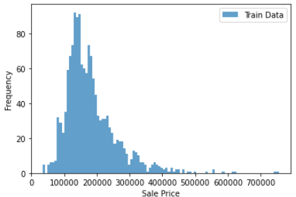
Exploratory Data Analysis
Dataset:
Train Data - 1460 samples, 79 Features
Test Data - 1459 samples w/o labels
Data:
36 numerical data, 43 categorical
Many features missing data
No duplications
Notes:
The train data has 1460 samples with house prices while the test data has 1459 samples that needed house price predictions. There are 79 features provided in which 36 were numerical and 43 were categorical nominal or categorical ordinal. We found several features with many missing data and in total 42 features had missing values in either training or testing data.
The distribution of the sales price is shown on the lower right, if you were curious. Most of the homes were sold at around $150,000 while ranging from near $35,000 to $750,000.

Slide 4
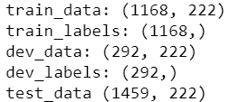
Exploratory Data Analysis
Missing Data:
Drop features when missing from 50% of samples
Convert to 0 or ‘None’
Data formatting:
Ordinal Data: Mapped to Ranked Integers
Nominal Data: Convert to Dummies
Normalized Features w/ Min-Max Scaler
Train_test_split at 80/20
Metric: Root Mean Squared Error between logarithm of the predicted value and observed sales price
Notes:
We decided to drop features if they were missing from 50% of the samples. Otherwise, we converted the missing values to 0 or ‘None’.
As discussed before, there are categorical data that required mapping to ranked integers if they were ordinal. Script shown at the bottom is an example of this mapping.
Nominal data were converted to dummies (1’s and 0’s).
We utilized the min-max scaler to scale the independent features between 0 and 1 and therefore, the features would have a fair comparison.
Train-test split was 80/20 randomized.
The result was 222 features instead of the original 79 leading to a sparse dataset.
*do not talk* Can look at coefficients to gauge which features are more important. We can compare features

Slide 5
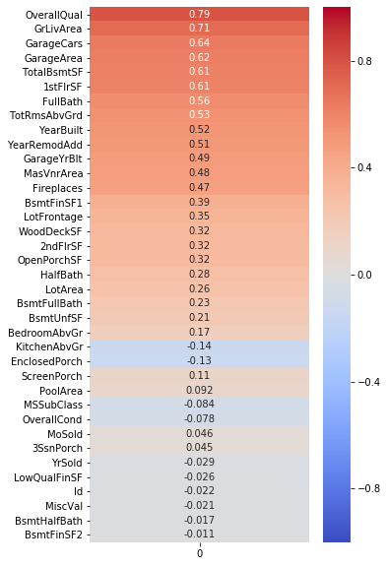
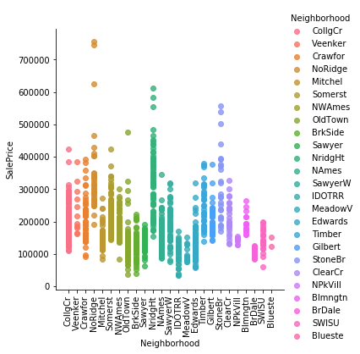
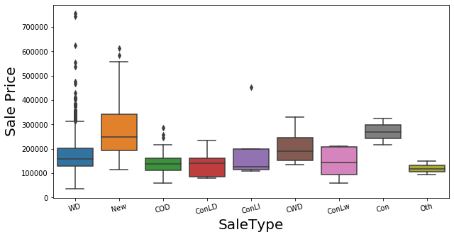
Exploratory Data Analysis
Correlation Graphics
Notes:
Here are a few of the plots that we conducted. We used box and lm plots for visualizing categorical data. For numerical data, we plotted the correlation of feature to sales price and ranked it by magnitude. Here, we see that new construction and some neighborhoods appear to have higher sales price. For numerical, the overall quality, square footage of ground floor, and garage size are among the most correlated features.

Slide 6
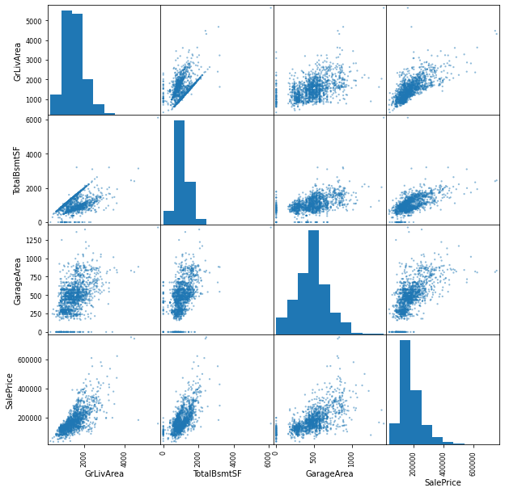
Baseline
Baseline model: Linear Regression
3 features
Ground Floor Living Area
Total Basement Square Footage
Garage Area
Estimated Function:
SalePrice = -20418.29 + 67.47*GrLivArea + 46.55* TotalBsmtSF+ 104.50*GarageArea
Mean Squared Log Error (MSLE) used as evaluation metric
Baseline MSLE: 0.043
Notes:
For our baseline model we went with a linear regression model selecting 3 features: ground floor living area, total basement square footage, and the garage area.
These features were selected based on our domain knowledge and their high correlation with the dependent variable, Sales Price
Our estimated function is as shown on the slide. Note that for the baseline we did not normalize the features, but moving forward we used the min/max scaler on features.
The primary metric we used to evaluate all of our models is the mean squared log error or MSLE. As you’ll see this number come up throughout our presentation.

Slide 7
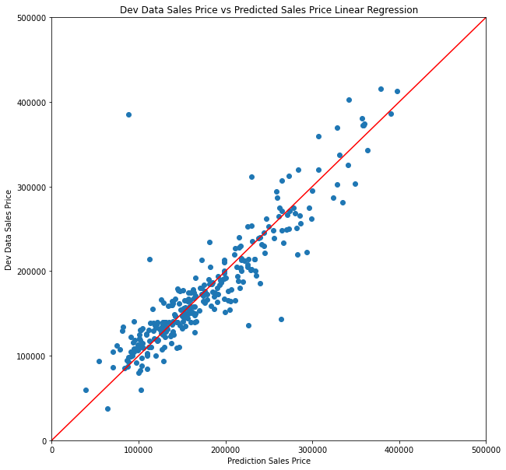
Linear Regression
???
Additional EDA
Outliers and negative predicted values
Sale Condition feature included trades, short sales, foreclosures and sales between family members
R² used as another metric for evaluation of linear regression models
R² : 0.748
Accuracy : 0.727
MSLE: 0.043
MSLE: 0.038
Notes:
We looked for ways to improve our linear regression model.
I wish I could say that this was a methodical, linear process, but it was actually lot of progress and backtracking.
With that in mind, this first step Im showing should have come in the beginning, but it was actually addressed towards the end.
We were coming across some frustrating outliers.
In some cases we were getting negative predicted sales prices (I can’t imagine a house so bad that you’d be willing to pay someone to take it off your hands)
And in other cases we were getting very large errors between the predicted and actual sales price like the one shown in the plot
We tied the issue back to a feature that included short sales, foreclosures and sales between family members, which I assume is a sale with a big discount unless you were trying to scam your own family.
So this sale condition feature might produce prices that are not indicative of a true sales price and specifically the linear regression model appeared to be more sensitive to this issue.
we therefore felt that it was appropriate to only include “normal sales” which dropped our train data from 1168 to 961 data points
Doing so resolved the issues we were encountering and improved the MSLE to 0.038.
And a side note, for the linear regression models, a goodness of fit measure was also used to evaluate performance. R squared is the value for the training data, while we used the term accuracy to denote the R squared for the development data

Slide 8
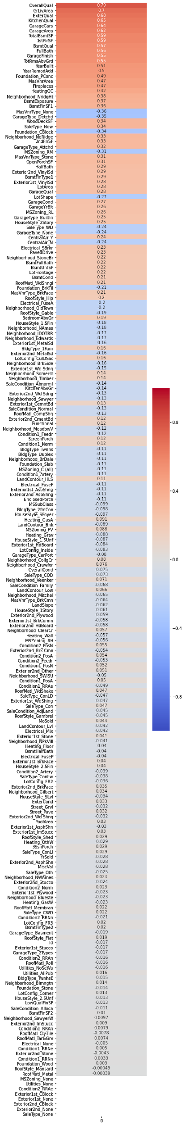
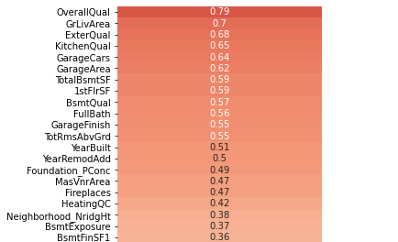
Linear Regression
Correlation with Sale Price
Feature Selection - Part 1
Feature Selection based on correlation with Sale Price
Created function to return features with a correlation greater than an input threshold
Used for-loop to find the optimal threshold
Threshold = 0.045
R² : 0.940
Accuracy : 0.863
MSLE: 0.038
MSLE: 0.030
Notes:
The next step in the process was feature selection.
Including all 221 features was problematic and it was determined that selecting features that had a high correlation with sales price would help
A function was created that accepted the correlation values for each feature and a desired correlation threshold. The function would return all the features that exceed that threshold.
Using a for loop to run through a list of various thresholds, we found the optimal threshold that produces the lowest MSLE in a process similar to our project 2 where we ran through various alpha values to find the best F1 score.
A correlation threshold of 0.045 and above was optimal and reduced our 221 features down to 137
This improved the MSLE to 0.030 and increased the R2 and accuracy

Slide 9
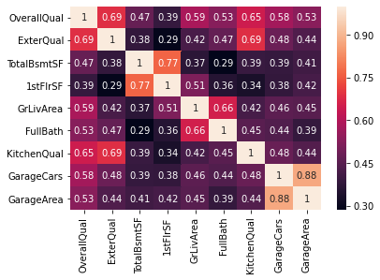
Linear Regression
Example Correlation Matrix
Feature Selection - Part 2
Feature Selection based on multicollinear features
Drop one of the multicollinear features
Expectation that it would increase performance and reduce overfitting
No significant improvement for this data set
R² : 0.939
Accuracy : 0.864
MSLE: 0.030
MSLE: 0.029
Notes:
Next step was to reduce the features that had a high correlation with other features
A function was created to identify features that had a correlation with another feature and drop the feature that had a lower correlation with sales price.
For example, the garage cars feature and garage area are highly correlated with each other, which makes sense given that the area of a garage is tied with how many cars it can hold.
So our function would drop the garage area feature which had a lower correlation with sales price
Our thinking was that reducing multicollinearity would reduce the gap between the R-squared and accuracy values, and thus improve overfitting
As you’ll notice, there was almost zero movement on our metrics, and this is one of those “I pictured this going a lot better in my head” moments
After reflecting on it, it may be due to the statistician vs predictive paradigm. So statistical power doesn’t always translate to predictive power.
I’m also taking 241 causal inference right now. So I might have been mixing up those two paradigms

Slide 10
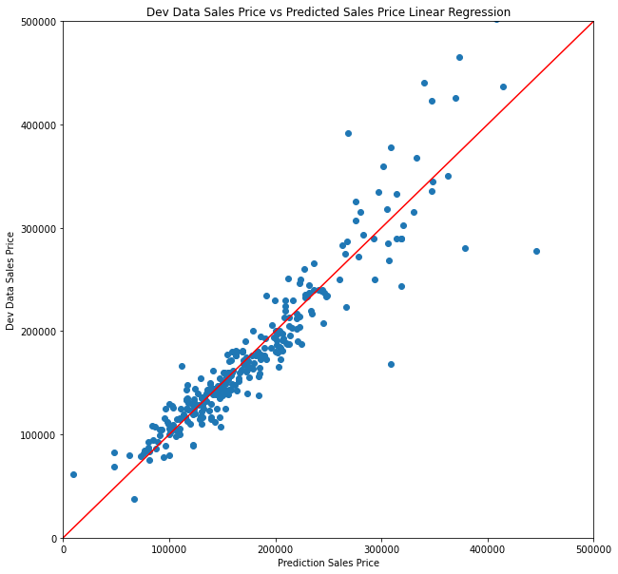
Linear Regression
Sales Price Predicted vs. Actual
Log - Linear Model
Predicted vs Actual Sales Price showed a trend of increasing errors with increase in house price
Good candidate for log-linear model
Increased R² and accuracy, while closing the gap. Improved predictive model
Reduced MSLE by over half
R² : 0.951
Accuracy : 0.921
MSLE: 0.029
MSLE: 0.012
Kaggle Score: 0.13361 (Top 36%)
Notes:
Last item, we looked at our plots for predicted vs actual prices and noticed a trend. It appeared to be a slight curve upwards in addition to an increase in errors as the actual price increased.
Based on that, it seemed that this was a good candidate for a log-linear model.
By taking the log of the sales price, we saw significant improvement in the R2 and accuracy, both were fairly high but just as important the gap closed which suggests that the training data was not overfitting and our model is more accurate.
In addition, our MSLE metric was reduced by over half.
For kicks, we submitted our results and using Kaggle’s metric (which is different than the metric we used), we got a 0.133.
Now I’ll turn it over to Nathan to talk about Gradient boosting and random trees

Slide 11
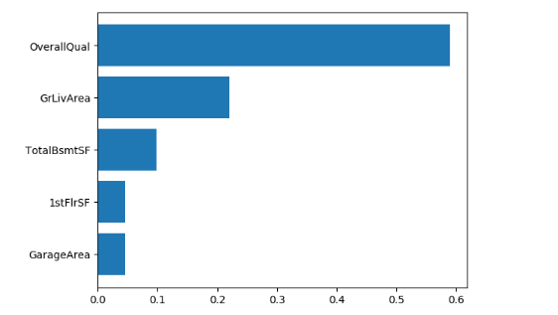
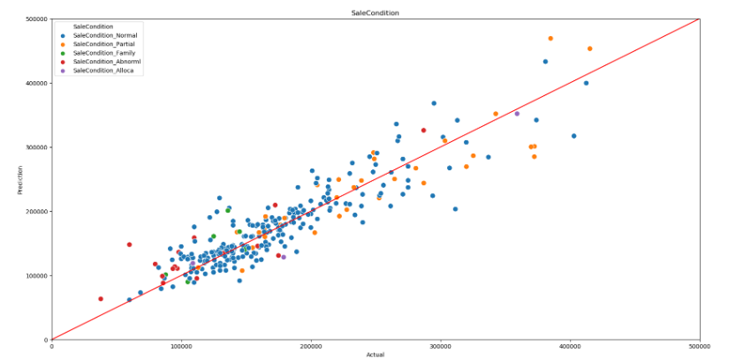
Gradient Boosting
MSLE: 0.028
Notes:
The first model that I used for boosting is Gradient boosting Which has a loss function that is able to adaptively handle home prices. I ran the model with the highest correlated variables from our EDA and found that they were also heavily weighted for Gradient boosting in feature importance as seen on top right graph. In addition, I created a graph that shows the Actual vs Predicted prices with Sale Condition as a color to see how well the model performed. MY final MSLE for gradient boosting is .028.

Slide 12
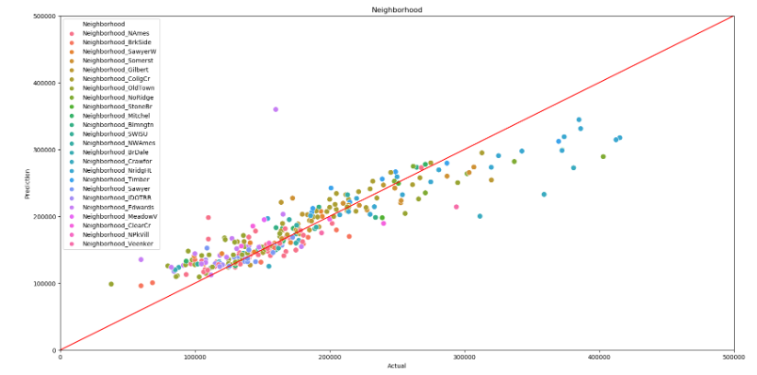
Bagging-Decision Tree
MSLE: 0.031
MSLE: 0.030
Notes:
My next technique was bagging. I used the same 5 variables as the previous model. This graph specifically color coded neighborhoods and we can see that there is a group of colors at the right of graph with higher actual prices that belong in the same neighborhood called Night Ridge. It seems that this neighborhood is not being properly adjusted with the model and therefore I added this as an extra dummy variable to see if there was improvement of my MSLE by 0.001 to .030

Slide 13
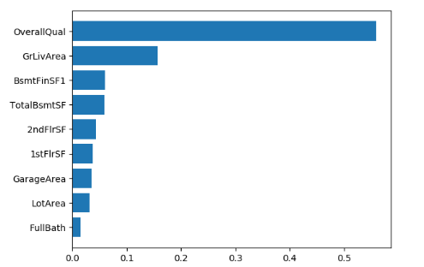
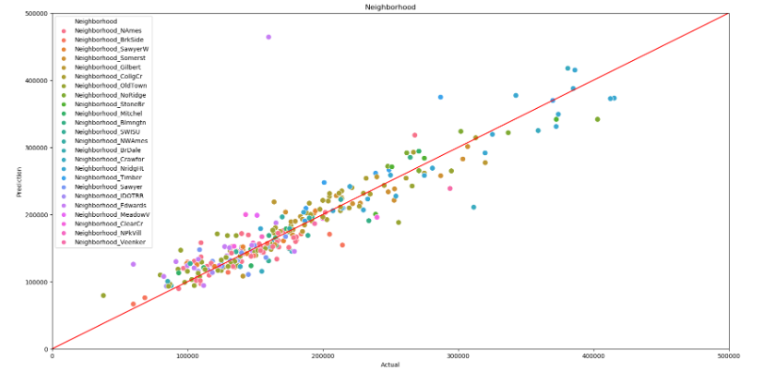
Random Forest
MSLE: 0.026
Notes:
My next model was a random forest as we wanted to create multiple decision trees and find the optimum point on which the trees split. We once again ran the feature importance and got similar features as with our boosting model. With these features we ran the random forest and got an MSLE of 0.026 which is an improvement over our previous models. Our neighborhood model looks pretty good with the dots pretty close to the accurate line.

Slide 14
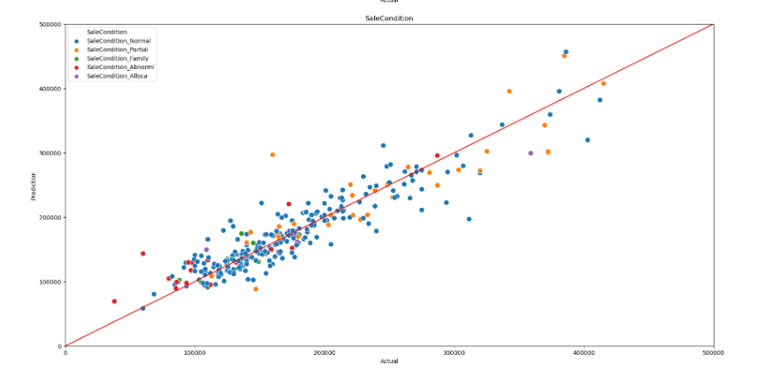
Extra Trees
MSLE: 0.024
Notes:
After using Random Forest, I wanted to see whether a random split for decision trees in my forest could be more efficient than the optimum point. I got a MSLE score of .024 which is slightly better than my random forest.

Slide 15
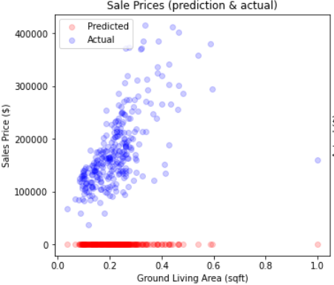
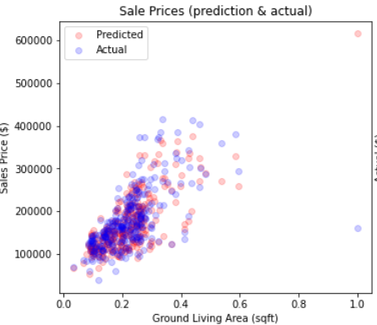
Neural Network
Varied parameters
Considerations:
Training time
Overfitting and Evaluation (MSLE)
Dataset
Single Layer
2-Layer
3-, 4-Layer
Epochs
Batch size
Optimizers and Learning Rates
Activation functions
Number of nodes
Dropout, regularizations
Applied findings from before
Notes:
For neural networks, only parameter tuning was done in which we optimized for for the mean-squared-log-error. We also considered training time, overfitting, and that we had a sparse dataset.
The process began with a single layer varying the epochs, batch size, optimizers and activation functions. Then we moved onto 2-layers and varied number of hidden layer nodes and dropouts and regularizations. Finally, we applied the findings on a 3 and 4 layer neural network.

Slide 16
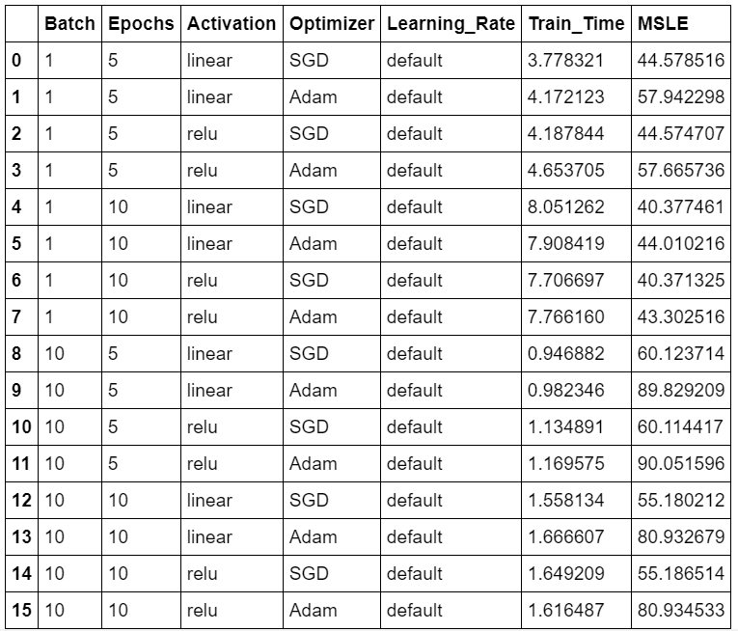
Neural Network - Epochs, Batch, Optimizer, Activation
Notes:
The dataframe here shows several parameter variations.
The red box is batch size of 1 which generally had a lower error than the blue box with batch size of 10. Similarly, more epochs equal lower error. In general, more steps/iterations mean that it will more likely reach convergence.

Slide 17
Neural Network - Epochs, Batch, Optimizer, Activation
Notes:
For activation, we can see that the linear and relu activations have similar error because in reality, they are similar. The relu is an identity matrix that just returns the same final prediction value except negative values are now zero. There could be benefit to using relu because of the non-negative house price predictions.

Slide 18
Neural Network - Epochs, Batch, Optimizer, Activation
Notes:
Here, you see that SGD optimizer performs better than the Adam optimizer at default learning rates which means that I should use SGD. However, further analysis on 2-layer networks showed that Adam optimizer converged faster when learning rate was higher while the SGD optimizer could bounce around leading to worse MSLE. I assume Adam’s optimizer’s momentum had to do something with this.
#what is momentum

Slide 19
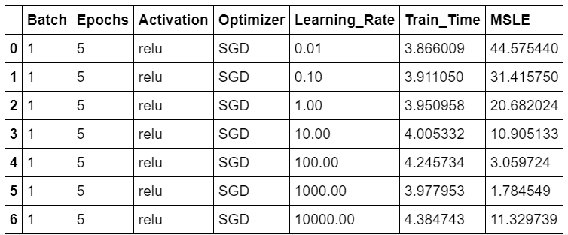
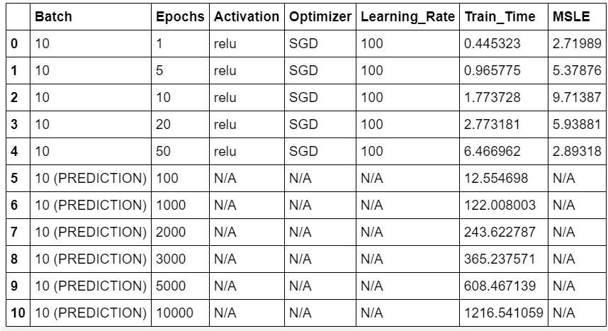
Neural Network - Learning Rate, Training Time
Notes:
Further variations included learning rates and predicting training time. When keeping the batches/epochs constant, increasing learning rate decreased the error. However, high learning rates can cause the weights to jump around a lot leading to unexpected increase in error. We should watch out for high learning rates.

Slide 20
Neural Network - Learning Rate, Training Time
Notes:
A prediction was done for the training time so that I know how long I can be away from the computer if I were to train for many epochs.

Slide 21
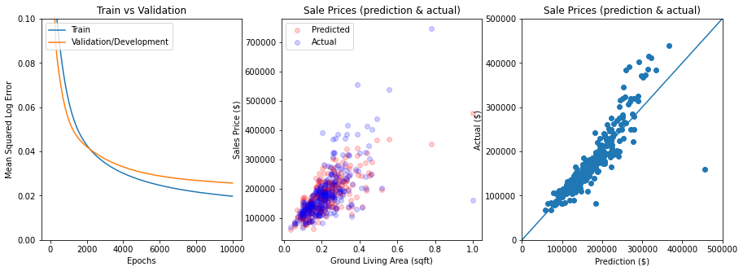
Neural Network - Single Layer
Mean Squared Log Error: 0.025
Kaggle Score: 0.1655 (Top 70%)
Notes:
After finding the ideal parameters, a 10,000 epoch, 2-hour training time model produced a low MSLE score and top 70% on Kaggle leaderboard.

Slide 22
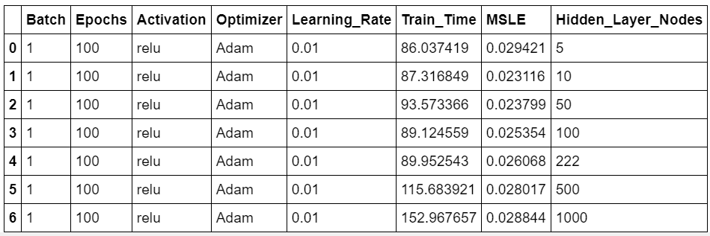
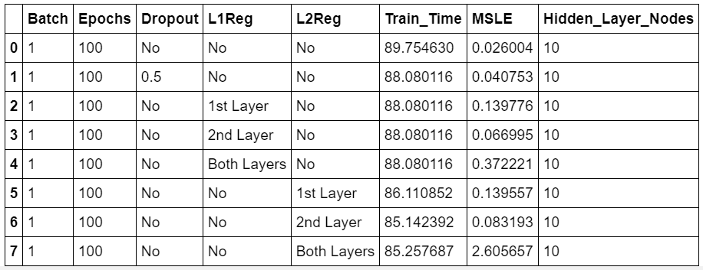
Neural Network - (2 layers) Nodes, Dropouts, Regularization
Notes:
The next improvement was to utilize 2-layer network. Here we varied number of hidden layer nodes, dropouts and regularizations.
For nodes, the theory is that a lot of the 222 features were 0’s and therefore, not that important and can be combined to be a few hidden nodes. As confirmed, the more nodes, the more error. However, 10 nodes performed better than 5 nodes meaning that the model can still account for variances when we utilize more than 5 nodes.

Slide 23
Neural Network - Nodes, Dropouts, Regularization
Lowest Error
Notes:
Varying dropout, L1 and L2 regularization did not help with the model. There may not be much overfitting.

Slide 24
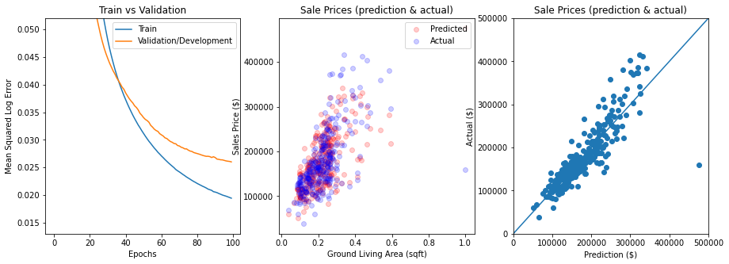
Neural Network - Two Layer
Mean Squared Log Error: 0.026
Kaggle Score: 0.1459 (Top 55%)
Notes:
Training time was only 90 seconds this time which produced a similar MSLE score but went up to top 55% on Kaggle leaderboard.

Slide 25
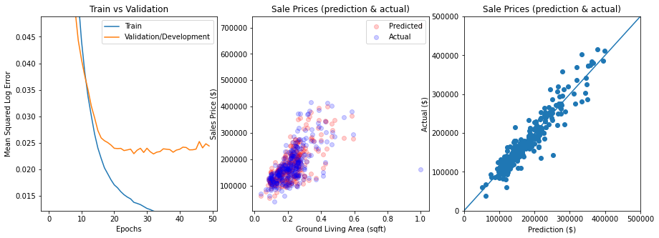
Neural Network - 3 & 4 layer
Mean Squared Log Error: 0.024
Kaggle Score: 0.1406 (Top 49%)
Notes:
The same parameters were utilized for a 3rd and 4th layer. It turned out, 3rd-layer was best. Yes, there looks be overfitting but the dropouts on all layers and L1 regularization on input layer did not improve the model. Future iterations would vary when to dropout and when to regularize.

Slide 26
Conclusion
Linear Regression - 0.134
Extra Trees - 0.151
Neural Networks - 0.141
Final Ensemble (Weighted Average) - 0.128
Notes:
In conclusion we took the best models by MSLE from each of our sections from kaggle with Linear Regression at .134, Extra Trees at 0.151 and Neural Networks at .141 to make a Final Ensemble of the weighted average and got a Kaggle score of .128

Slide 27
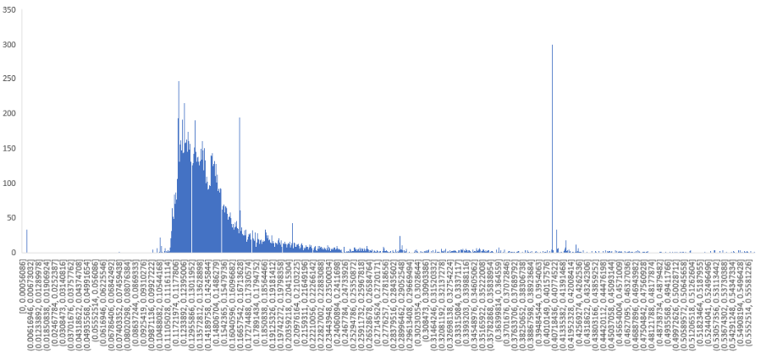
Questions?
Top 27%
Notes:
Nathan

